Slide 1
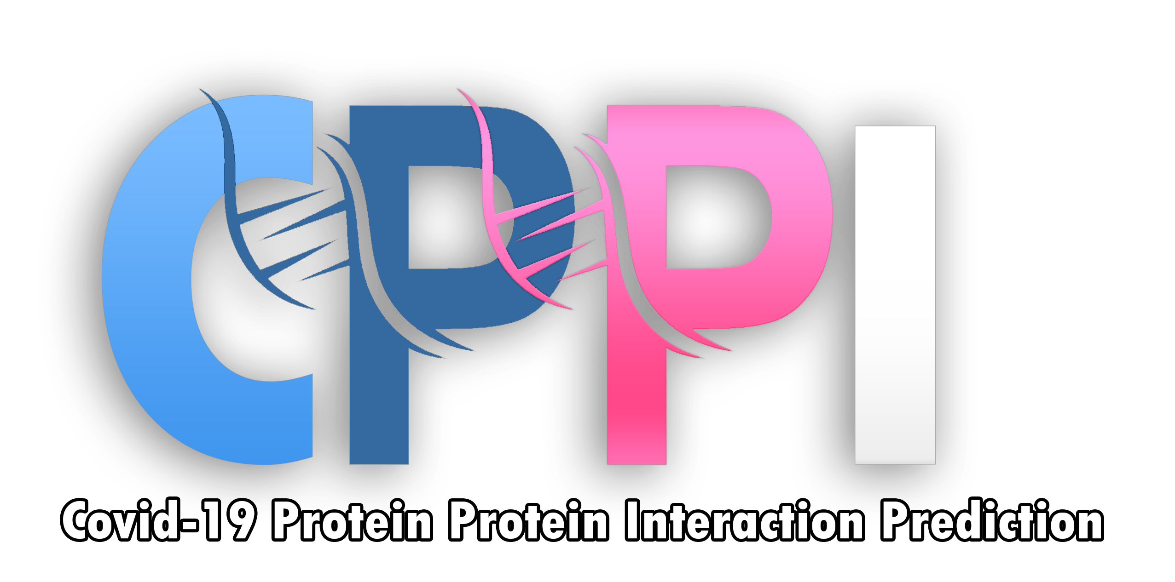

Predicting COVID-19 Protein-Protein interactions
Supervised by
Dr. Hanaa Bayomi
Dr. Ahmed Farouk
TA. Eng. Sara El-Nady

Slide 2


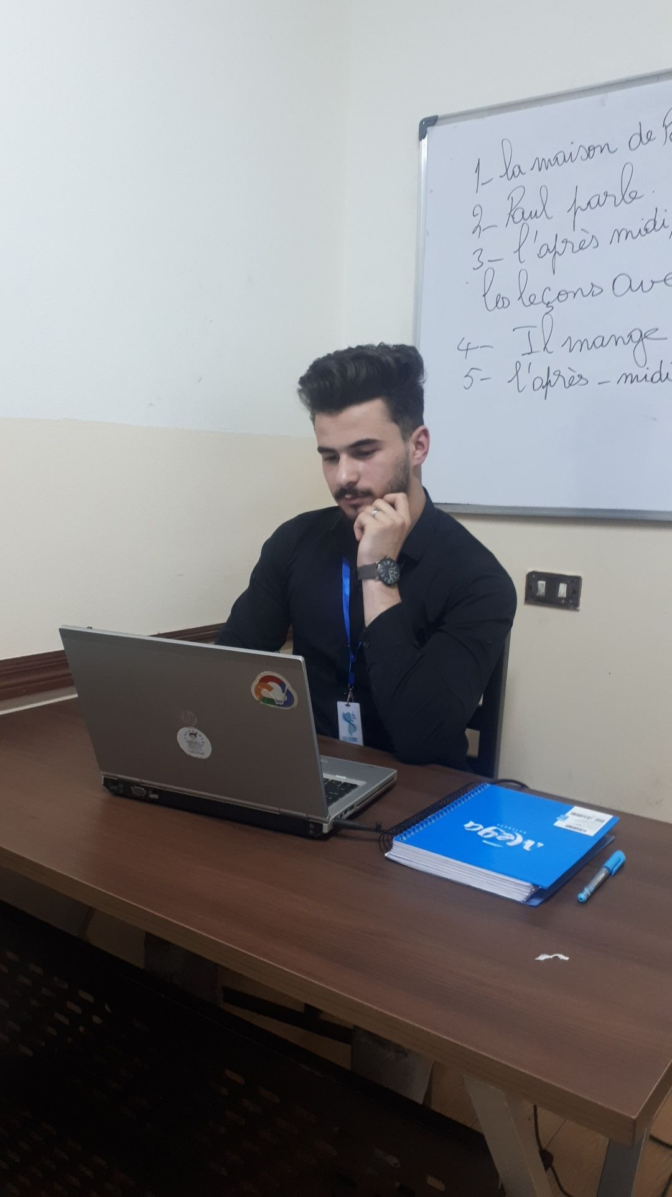
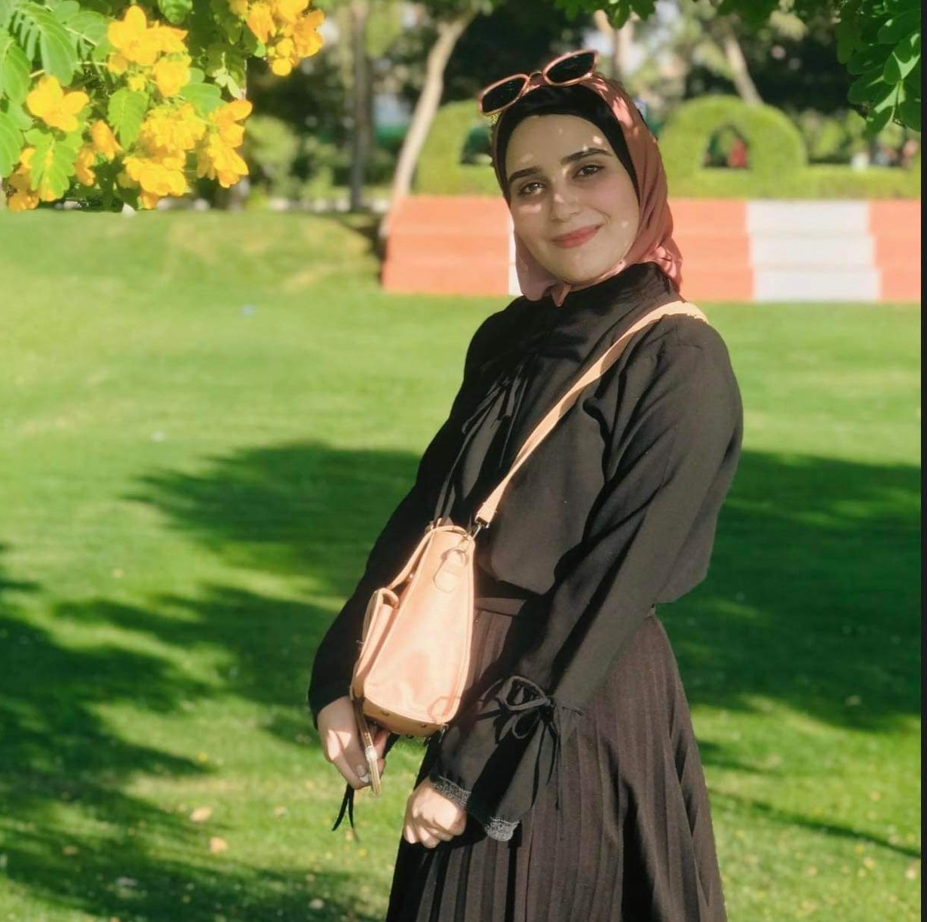
Our Team
Tarek Idrees
Hasnaa Ali
Mohamed Mahmoud
Mohamed Idrees
Mennatallah Mabrouk

Slide 3
Project Idea
The general idea of our project is to predict if a human protein interact with SARS-COV2 proteins or not.
Domain of interest
Bioinformatics.

Slide 4
Agenda
Introduction
Problem
01
02
Solution
Related Works
03
04
Intro to the project field.
Defining the problem that we are going to solve.
How we will solve the problem.
Related studies to our project.
Conclusion
05
What we get out of our Project

Slide 5
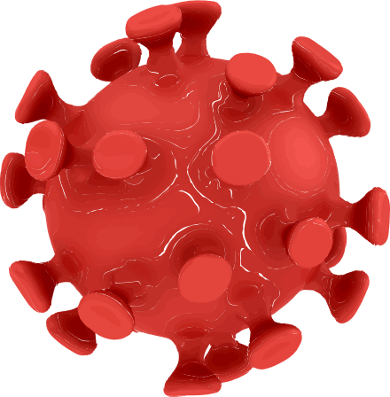
Introduction
Corona virus incident occurred in Wuhan, China.
Spread rapidly to every region of the world.
To have knowledge of how the virus contacted the host during infection, and to develop new drugs or to reuse existing drugs.
Clinical trials both RNA and protein sequences are used effectively.
One of these methods is based on protein–protein interactions.

Slide 6
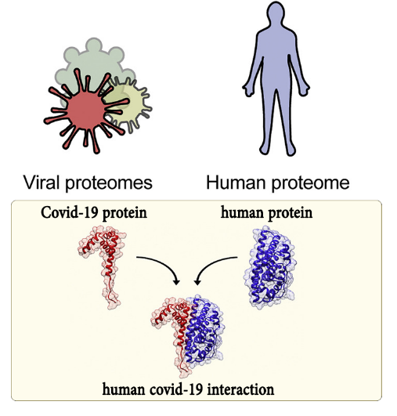
Protein–protein interactions
Protein–protein interactions (PPIs) are physical contacts.
Inactivate a protein.
Change protein function.
Demonstrate a new function that neither protein can exhibit alone.

Slide 7
Problem
Protein–protein interactions are important :
to examine protein functions
to determine the cause and progression of diseases.
When we predict the interaction, we will be able to have knowledge of how develop new drugs.
So how we know PPIs ?
Experimental Methods
(wet lab)

Slide 8





Problems of Experimental Methods
1
2
Produce large amount of data
Needs laboratory equipment
3
4
Cost too much time and money
Sensitive to environment

Slide 9

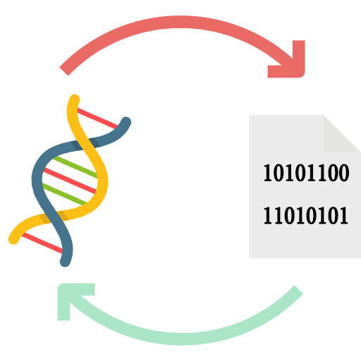
Solution
The solution is using Computational Methods.
Computational Methods :
Fast - Handle Big Data – No Equipment – doesn’t sensitive to environment
Can be used to discover new PPIs
Identify errors in the experimental PPI data.
1
interact
0
doesn’t interact
1- Genomic sequences
2- Mapping
3- Classification
Computational method Steps

Slide 10
Our Project Idea
We will use :
Two Mapping Methods.
Machine and Deep Learning models.

Slide 11
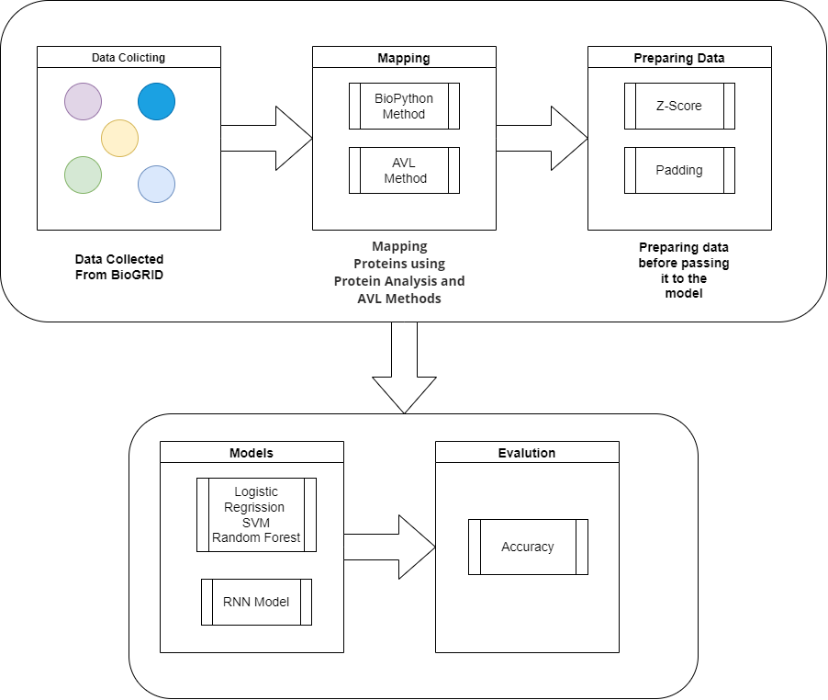
System Architecture
CPPI System Architecture

Slide 12
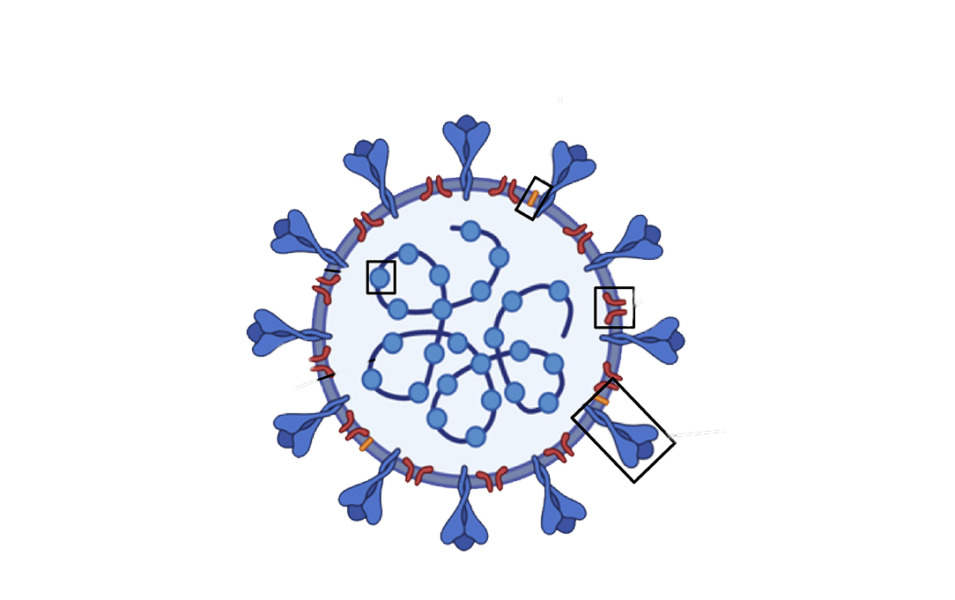
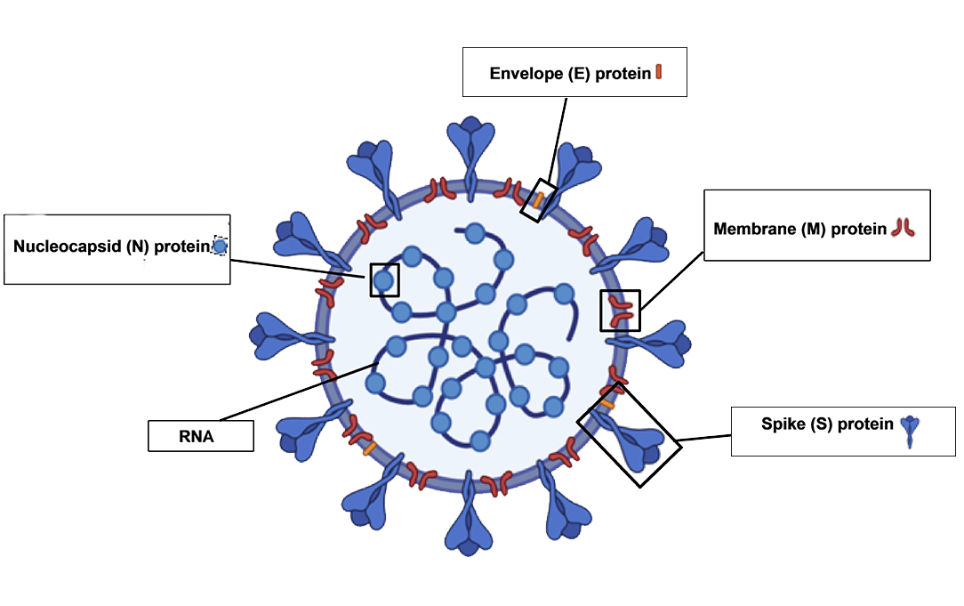
1-Data Collection
Structural
Covid-19 consists of:
Four structural proteins.
Six non-structural proteins (key to understanding protein interactions).
Structural
Structural
non-structural
Structural
orf3a | orf3b | orf6 | orf7a | orf7b | orf8
Covid-19 Non-Structural Proteins
no interaction of the orf7b protein was observed

Slide 13
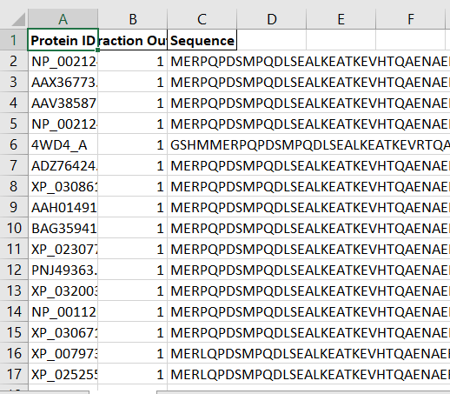
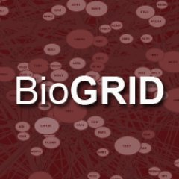
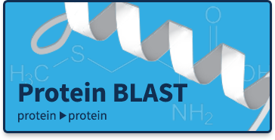
1-Data Collection
1- Bring PPIS
from BioGrid
Database
2- increase data
by alignment it by BLAST
3- Final Dataset

Slide 14
Phase 1

Slide 15
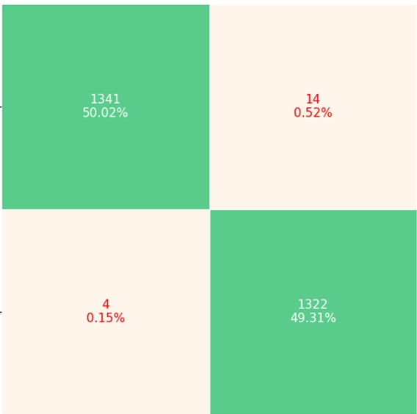
Phase 1
Mapping Method (BioPython Protein Analysis).
Normalization with Z-Score.
Build the model with 3 different classifiers (SVM – LR – RF).
Classifier | Accuracy | Precession | Recall
Logistic Regression | 0.878 | 0.879 | 0.878
SVM | 0.982 | 0.982 | 0.982
Random Forest | 0.993 | 0.992 | 0.992
Random Forest Confusion Matrix
Models Accuracy Tables

Slide 16
Phase 2

Slide 17
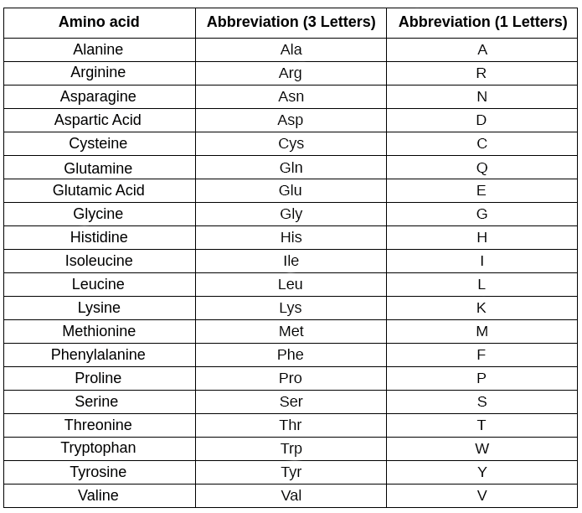
2-Mapping Method (AVL Tree)
We will use AVL Tree is algorithm-based method to map the sequences.
We are have 20 amino acids we will add these amino acid to AVL tree in alphabetical order.
For instance: first we add Alanine (A) in the AVL tree since it is the first amino acid in alphabetical order and we insert Arginine (R) and so on.
Amino acids in alphabetical order

Slide 18
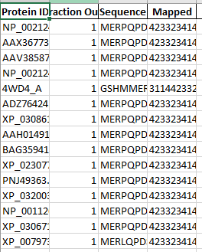
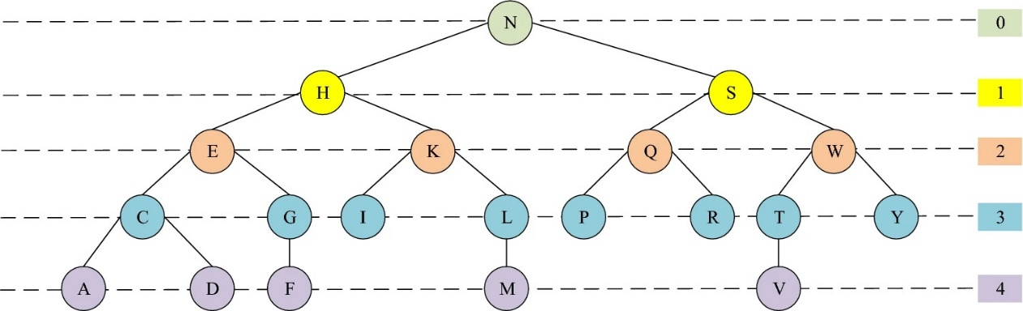
2-Mapping Method (AVL Tree)
After the insertion process, we calculate the depth values of each node.
Let say we have a protein sequence
S(n) = MHIILKFDASHN
The numerical representation of this sequence
is calculated S(n) = 413332444110
Dataset after mapping with AVL
Depth values of each amino acid

Slide 19
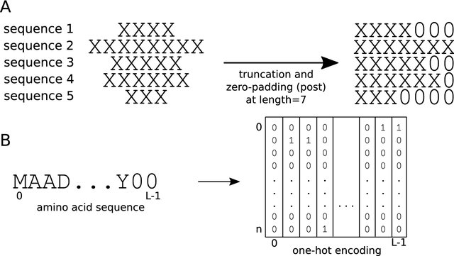


3-Preparing Data
We will pass our data to AVL tree (mapping method) that gives us a numeric representation to sequences
The mapped protein sequences were then padding to the maximum sequence Length
These numeric representation will be our sequences.
Post Padding
Padding Sequences

Slide 20
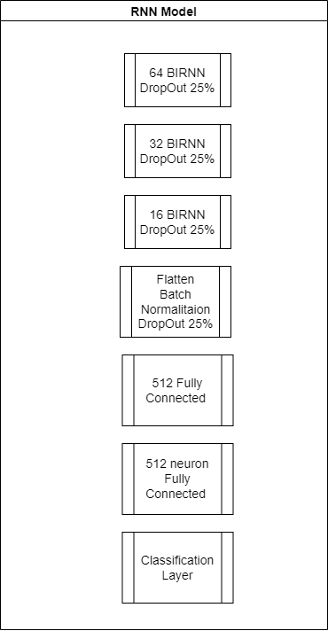
4-Building Model and Evaluating
Only 20% of the original dataset was considered as a blind dataset (test data). The remaining 80% was used in training.
Build the model with RNN Deep learning algorithm
RNN Model Structure

Slide 21
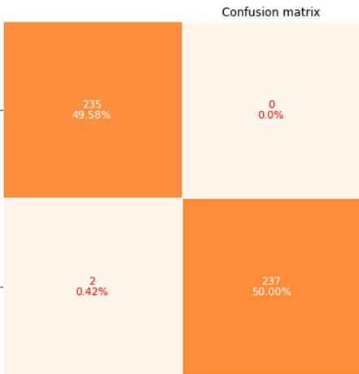
Confusion Matrix of RNN
Our model for AVL with RNN made 99.58% accuracy without over-fitting or biased which is an accepted model and accuracy.
RNN Confusion Matrix

Slide 22
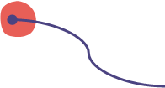
Related Work
Study
Study
Prediction of protein-protein interactions based on elastic net and deep forest.(2021)[2]
Study
Predicting Protein-Protein Interactions from Matrix-Based Protein Sequence Using Convolution Neural Network and Feature-Selective Rotation Forest. Sci Rep 9, 9848 (2019).[1]
A Novel Protein Mapping Method for Predicting the Protein Interactions in COVID-19 Disease by Deep Learning (2021)[3]

Slide 23
Related Work (Comparison)
 | Study[1] | Study[2] | Our project (phase 1)
Mapping Method | Computational based (PSSM) | Physiochemical (Hydrophobicity amino acid classification) | Physiochemical Computational (Protein Analysis)
Classifier | CNN (convolutional Neural Network) | Deep Forest | Logistic Regression SVM Random Forest
Accuracy | 97.75% | 71.4% | 87.8% 98.2% 99.3%

Slide 24
Related Work (Comparison)
 | Study [3] | Our project (phase 2)
Mapping Method | AVL (algorithm-based) With Normalization Z-Score | AVL (algorithm-based) With padding
Classifier | RNN (recurrent neural network) | RNN (recurrent neural network)
Accuracy | 97.76% | 99.58%

Slide 25
Project Specifications

Slide 26
Functional Requirement
1) Registration: If this is the first time for the user to use the website, he/she will register.
2) Log in: If the user already registers before, the user will log in to the app.
3) PPI Prediction: The user will input the sequence that he/she wants to predict the interaction of this protein with COVID-19 proteins.
4) profile: the user can show his history, and he could back to the history and check the results and accuracy.
Notes:
Functional requirement
1) Registration: If this is the first time for the user to use the website, he/she will register.
2)Log in: If the user already registers before, the user will log in to the app with his user’s name and password.
3)PPI: The user will input the sequence that he/she wants to predict the interaction of this protein with COVID-19 proteins. The PPI will be processed and transferred to phase that contains prediction process. Is protein having interaction or not? with four different models RNN, SVM, RF and LR.
4) profile: the user can show his history, and he could back to the history and check the results and accuracy.

Slide 27
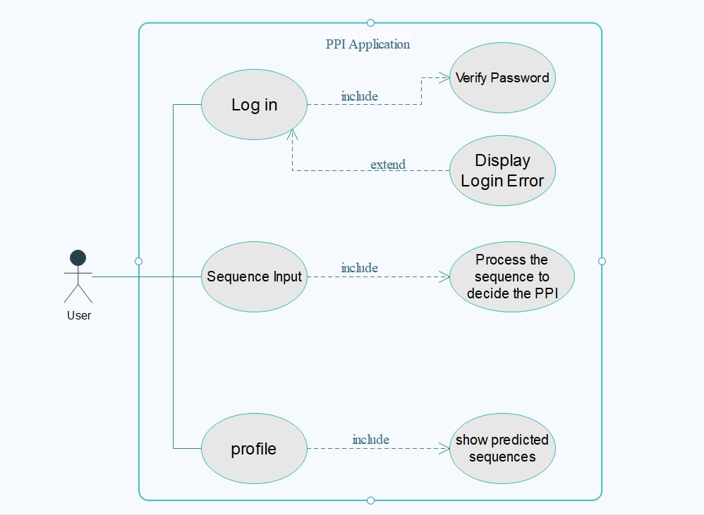
Use-case Diagram
CPPI use-case Diagram

Slide 28
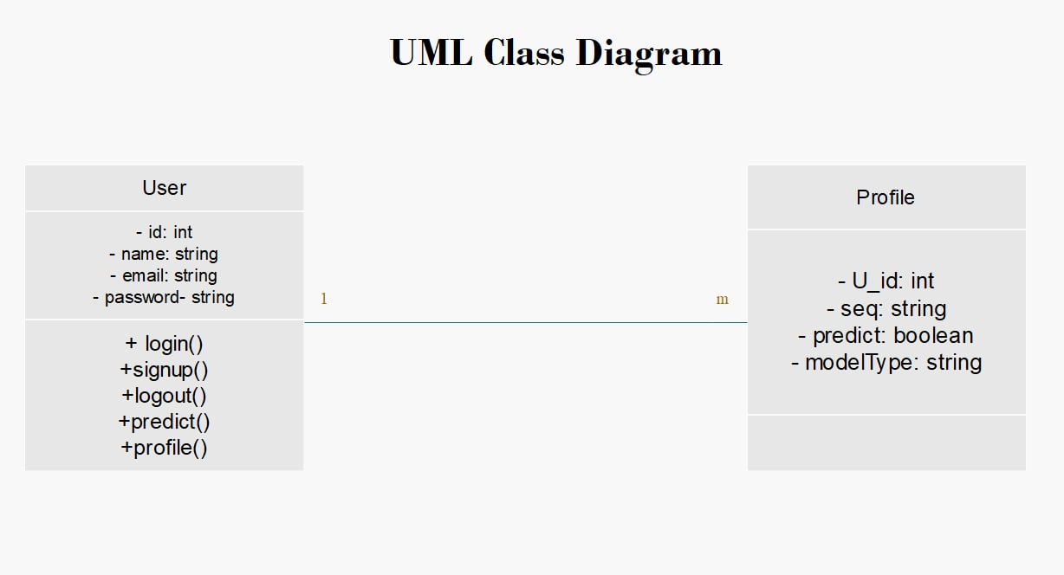
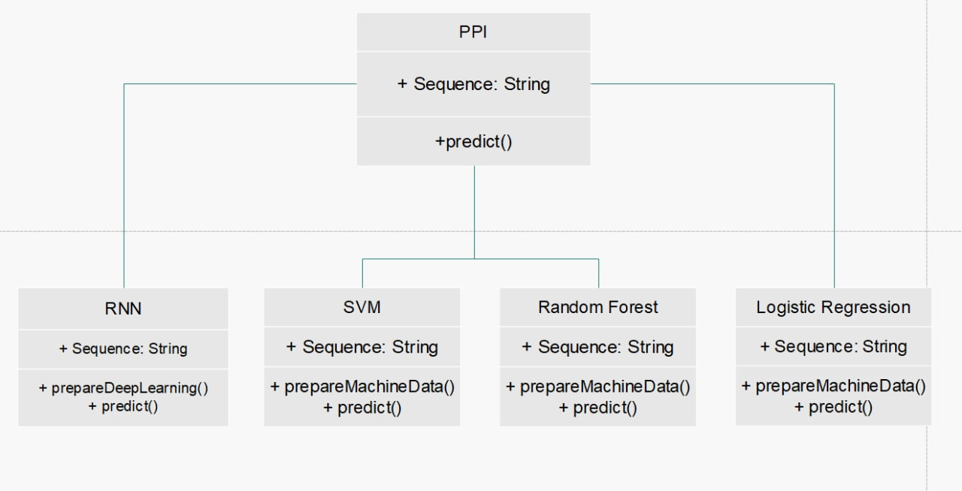
Class Diagram
CPPI Class Diagram

Slide 29
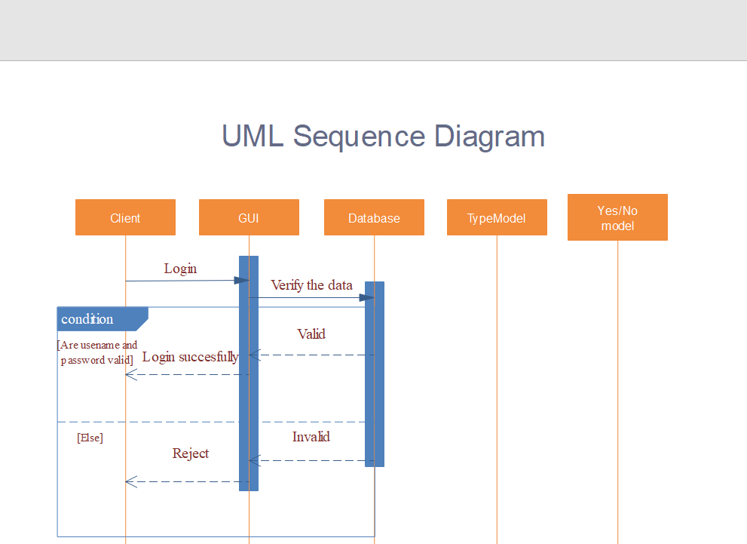
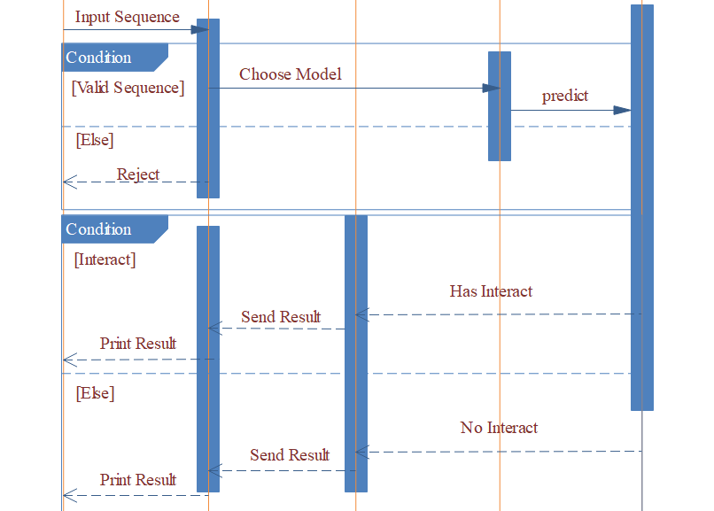
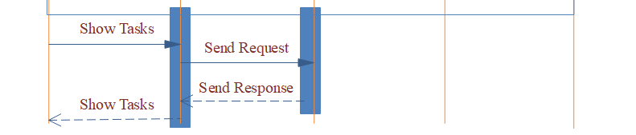
Sequence Diagram
CPPI Sequence Diagram

Slide 30
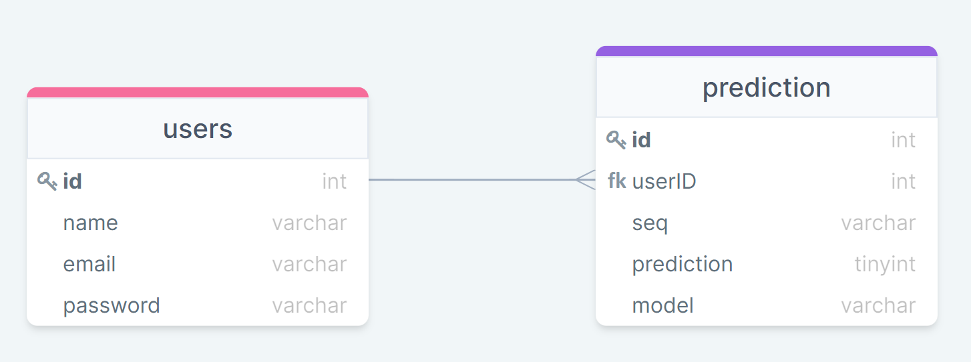
ERD
CPPI Entity Relationship Diagram

Slide 31
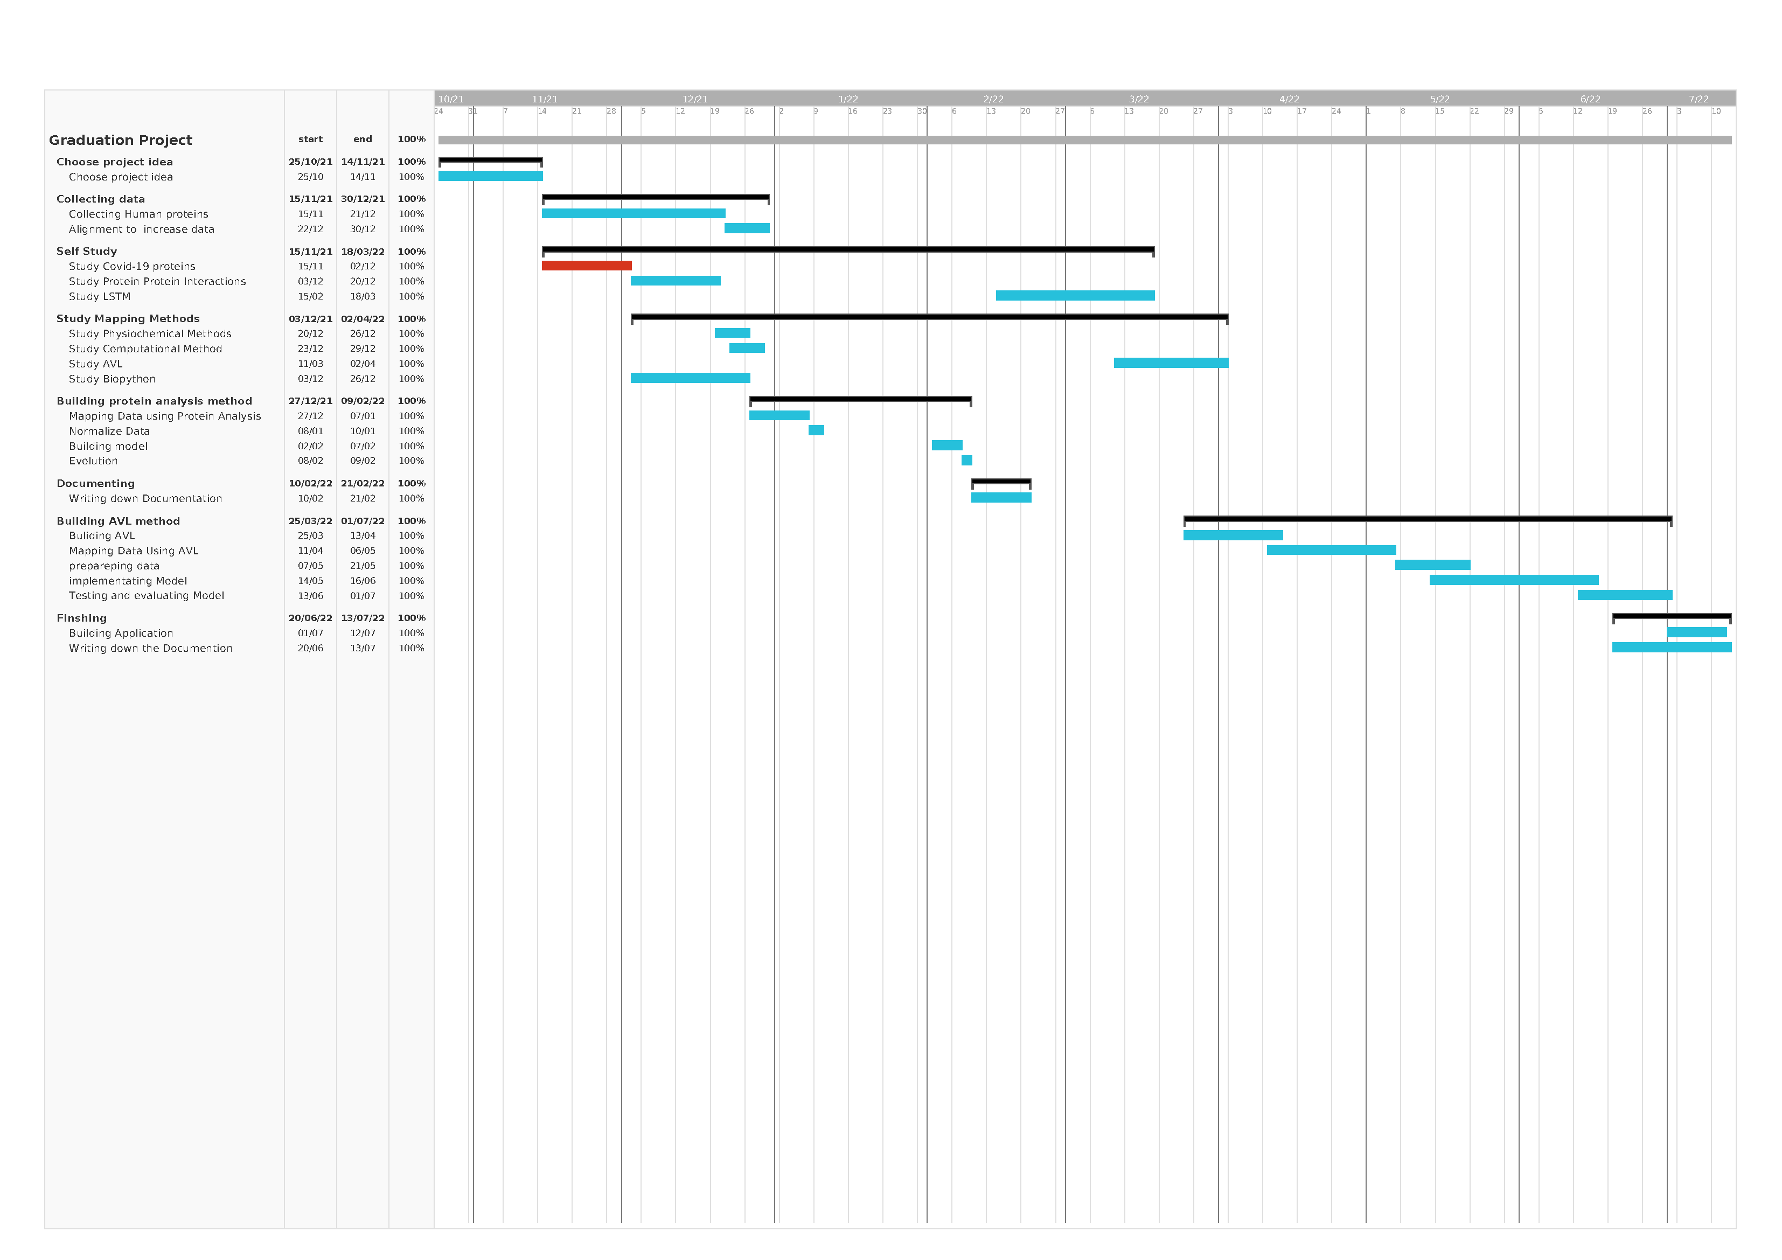
Time Plan

Slide 32
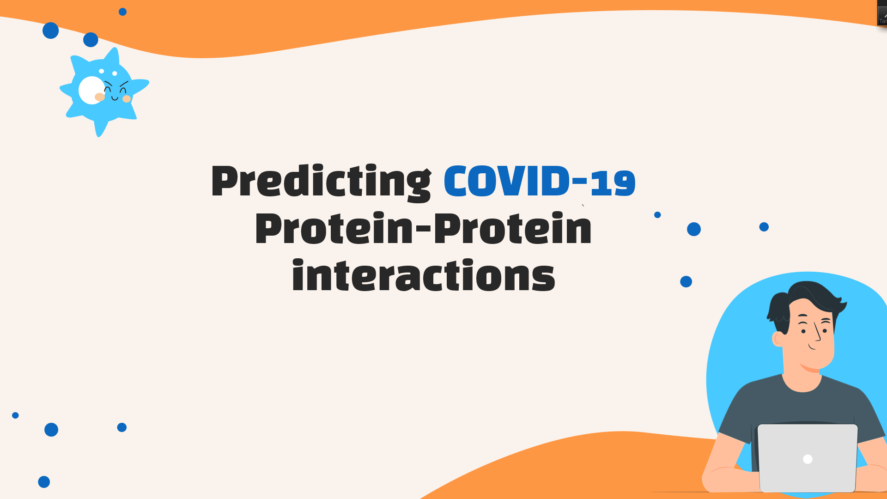
Conclusion
In this project, an Biopython protein-mapping method and AVL tree mapping method were proposed to predict the interactions of non-structural proteins belonging to COVID-19 with other human proteins, data collected from the BioGrid dataset .
in phase 1 we mapped the data using protein analysis method , and the data normalized using z-score ,then the data is classified it with random forest which gave us 99.33% accuracy.
In phase 2 we mapped data using AVL tree we managed to apply non physiochemical feature extraction (AVL) , protein sequence represented as a numeric representation according to each amino acid depth in AVL , then these sequence classified by RNN and get 99.58% accuracy which is a great for algorithm-based mapping method .

Slide 33

Demo Time

Slide 34
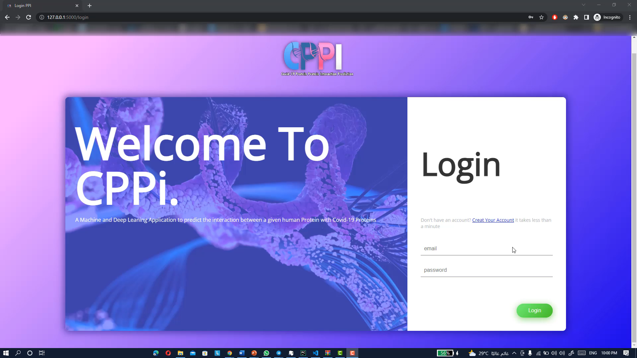

Slide 35
Thanks!

